Slide 1
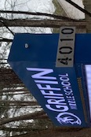
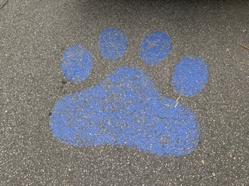
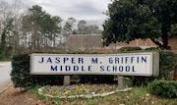
Welcome to Griffin MS
Home of the Wildcats

Slide 2
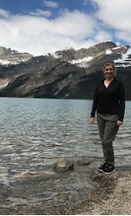
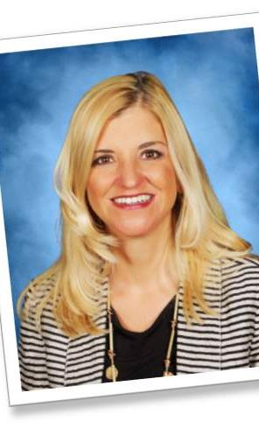
Meet our Principal Dr. Loralee Hill

Slide 3
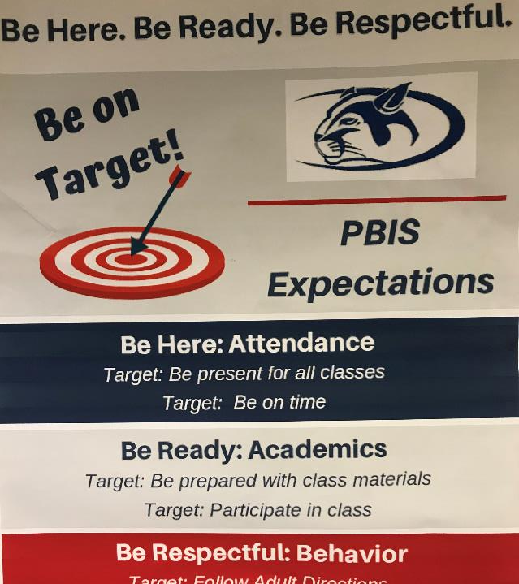
We are a PBIS school
Be Here
Be Ready
Be Respectful
And you will be great at Griffin

Slide 4
The nurse and student support is by the 8th grade hallway

Slide 5
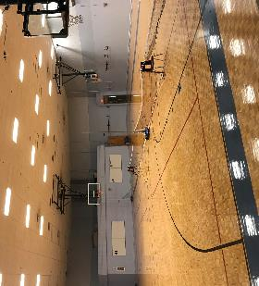
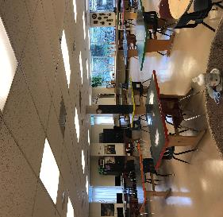
Connections include
Band, Orchestra, Chorus, Art
PE, Health, Family Consumer Science, Business and Technology

Slide 6
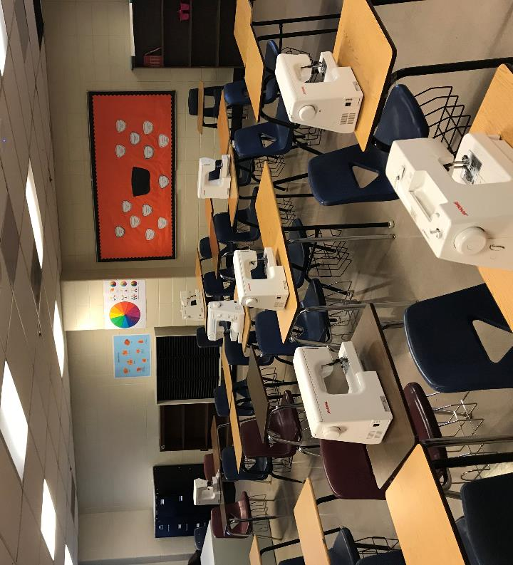
Family and consumer science

Slide 7
The café Nacho Wednesday

Slide 8
We have the best media area

Slide 9
Griffin has many opportunities for you to thrive as a scholar!! CLUBS Band Women of Excellence Soccer Art Drama Beta club No Place for Hate

Slide 10
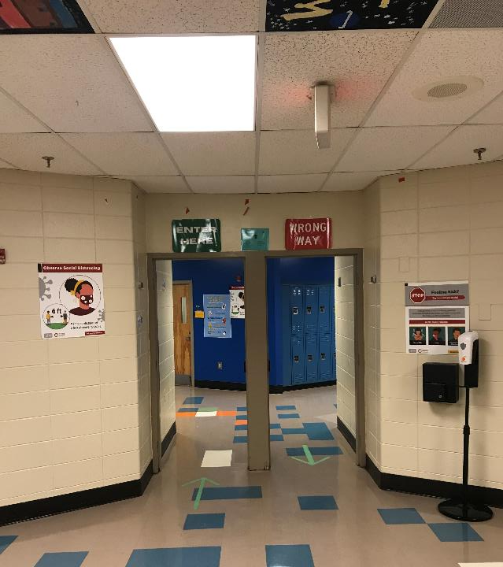
The 6th grade POD

Slide 11
6th grade hallway

